Slide 1

DS BANK

Slide 2

NAME – DIVYANG SHRIVASTAV
PROJECT – DS BANK MANAGEMENT SYSTEAM
FACULTY INCHARGE – SANDIP SIR
CLASS CODE - 404

Slide 3
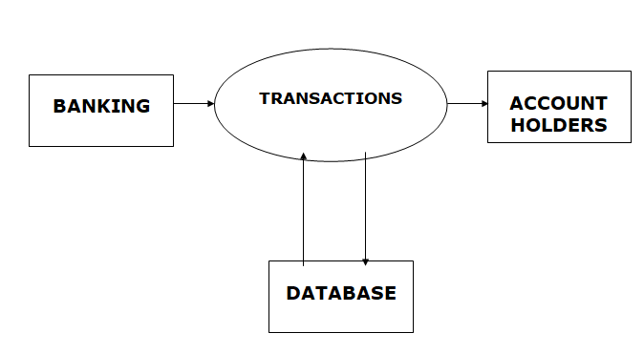

Slide 4

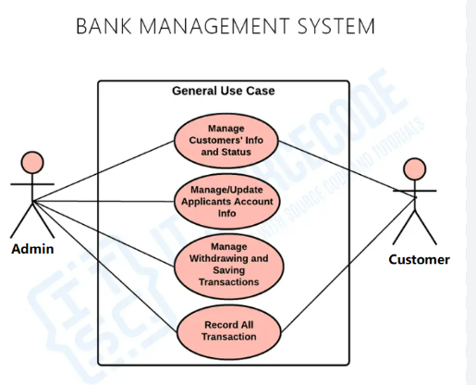
A bank management system (BMS) is a software application that helps financial institutions manage their operations, including customer service, risk management, and operational efficiency. BMS can also help banks provide better services to their customers.

Slide 5

We have 6 types Off MANAGEMENT SYSTEAM
1 – BANK MANAGER
2 - EMPLOYEE
3 - CUSTMORE
4 - ACCOUNTS
5 – DEPOSITE
6 - LOANS

Slide 6

OBJECTIVE OF THE PROJECT -:
The objective of a Bank Management System project is to developa software solution that
efficiently manages banking operations such as account creation,
transactions, balance management, loan processing, and customer data handling.
The system aims to streamline banking processes, improve accuracy, enhance customer service,
and ensure secure and user-friendly interaction for both customers and bank employees.

Slide 7

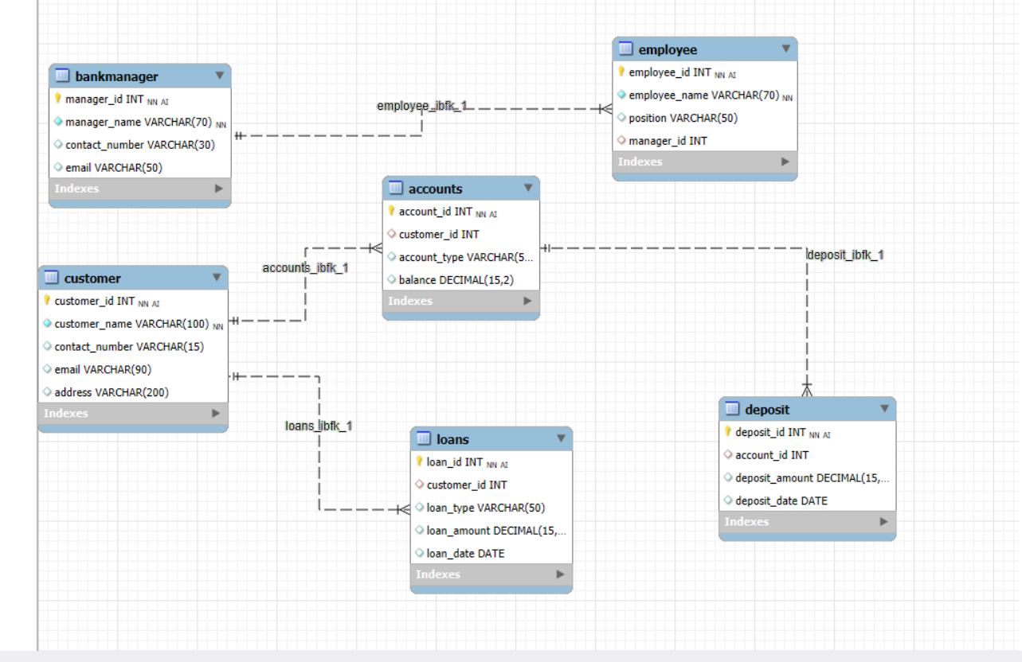
ER diagram (Entity-Relationship diagram) is a visual representation of the entities in
a database and the relationships between them.

Slide 8
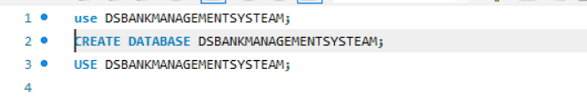
CREATE DATABASE

Slide 9
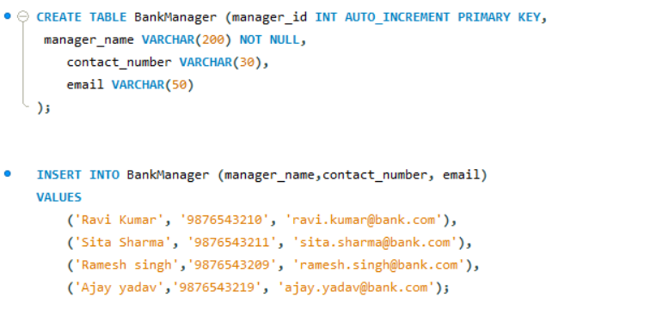
1 – EMPLOYEE TABLE

Slide 10
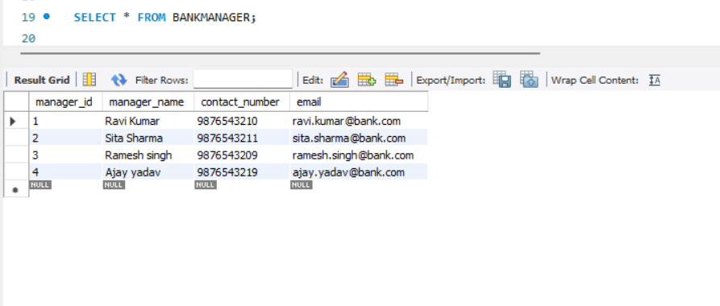
SELECT * FROM BANKMANAGER;

Slide 11
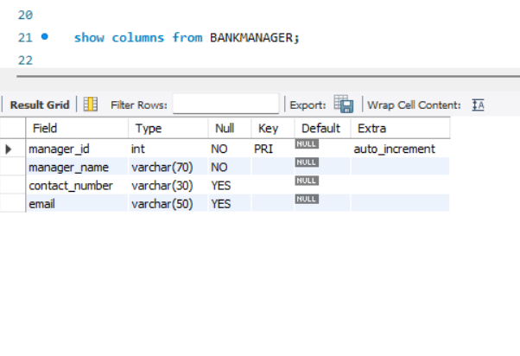

Slide 12
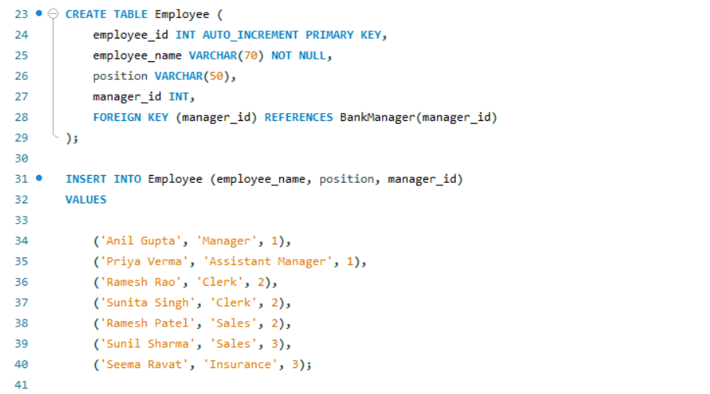
2 – EMPLOYEE TABLE

Slide 13
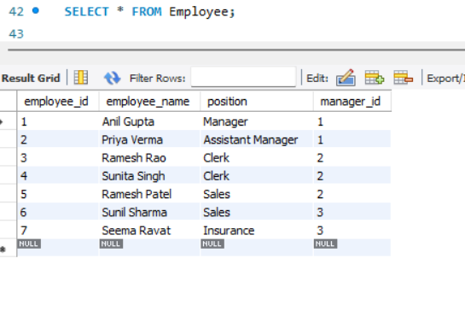
SELECT * FROM EMPLOYEE

Slide 14
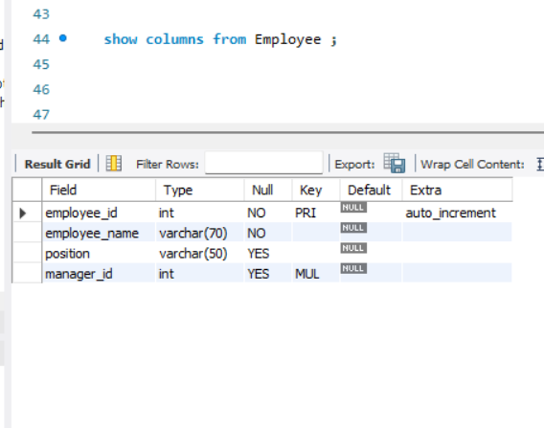

Slide 15
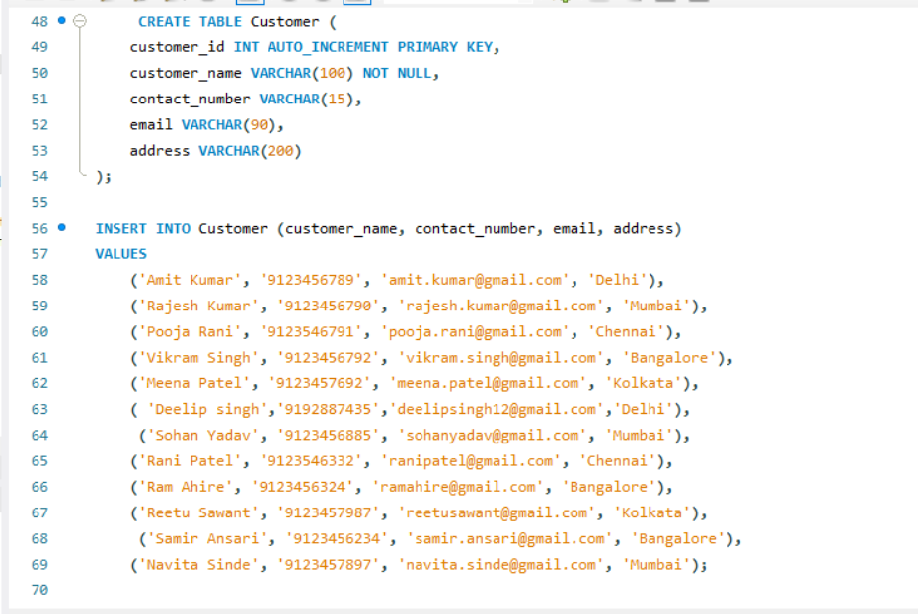
3 - CUSTMORE

Slide 16
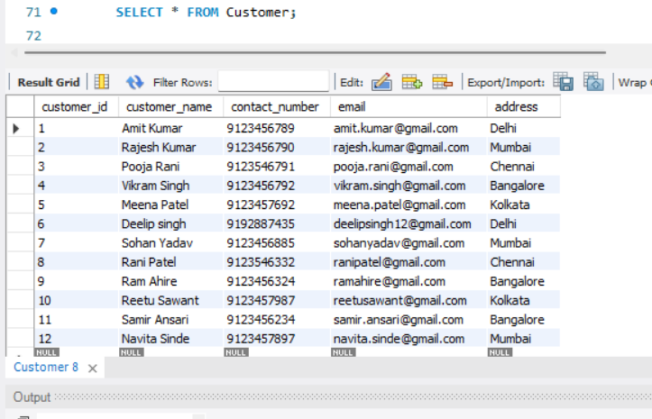
SELECT * FROM CUSTOMER;

Slide 17
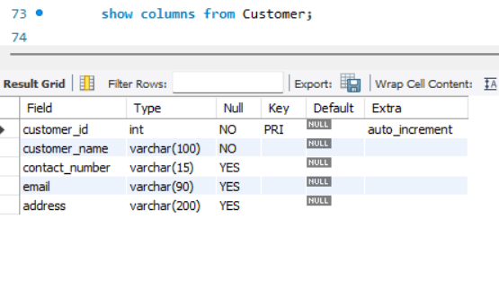

Slide 18
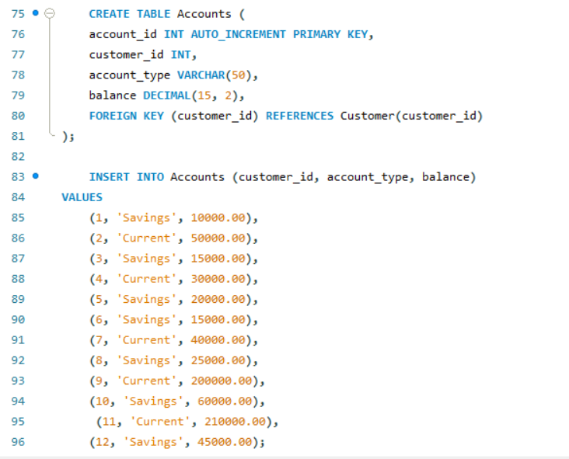
4 - ACCOUNTS

Slide 19
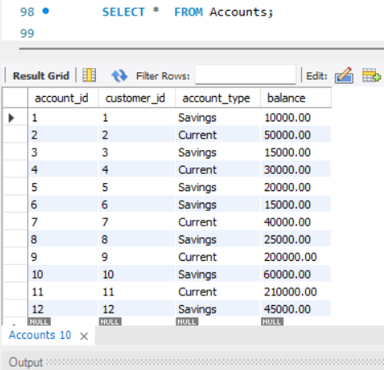
SELECT * FROM Accounts;

Slide 20
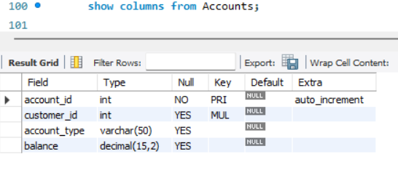

Slide 21
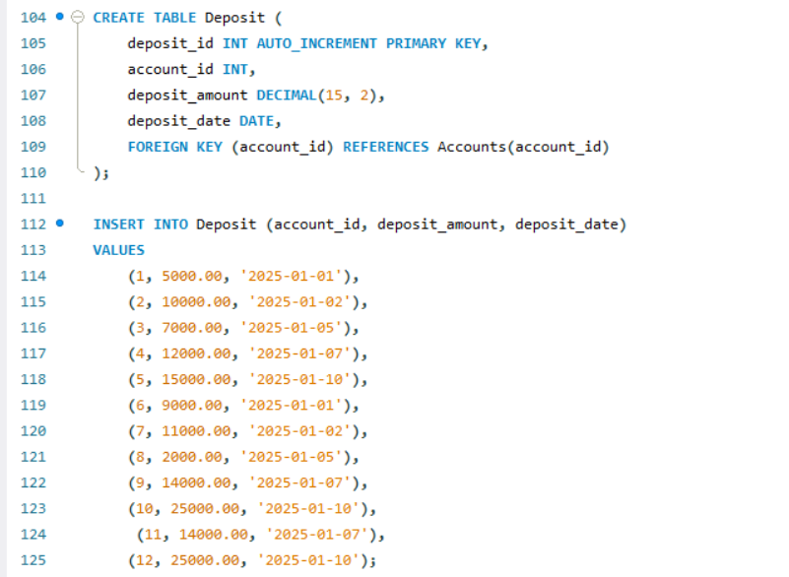
5 - DEPOSIT

Slide 22
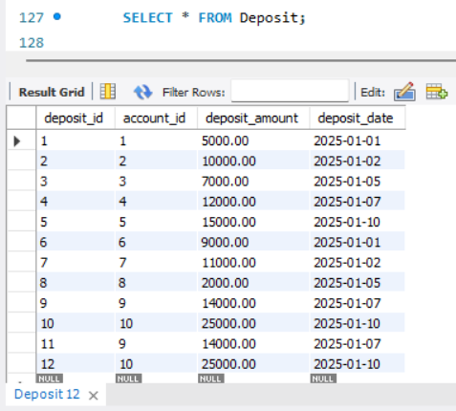
SELECT * FROM Deposit;

Slide 23
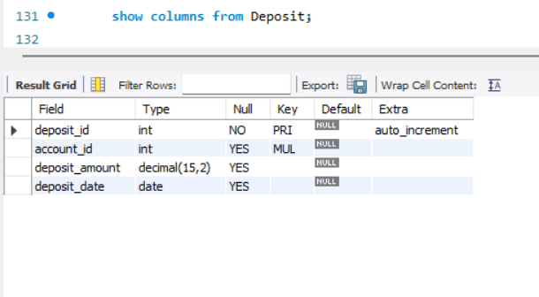

Slide 24
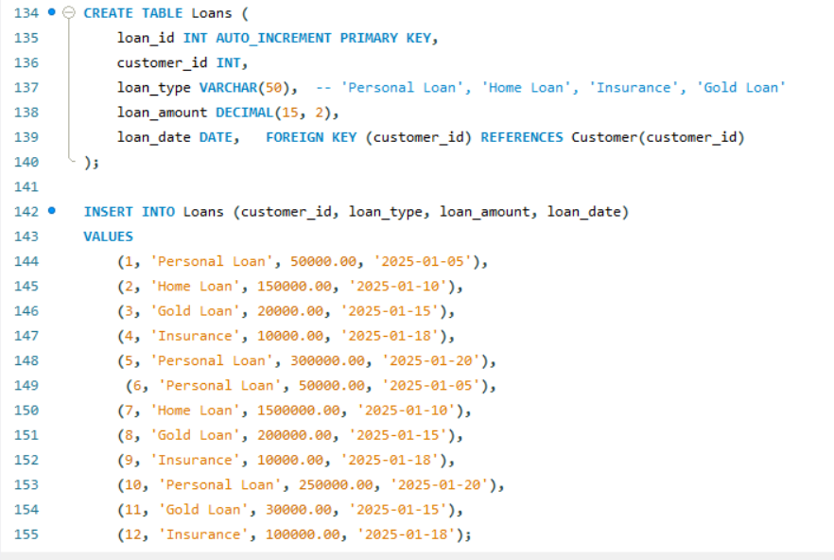
6 - LOANS

Slide 25
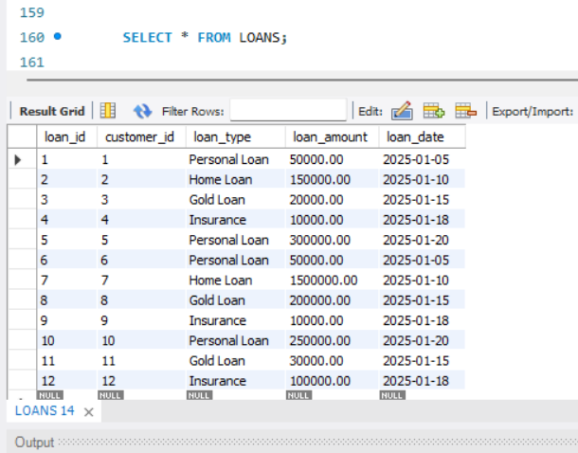
SELECT * FROM LOANS;

Slide 26
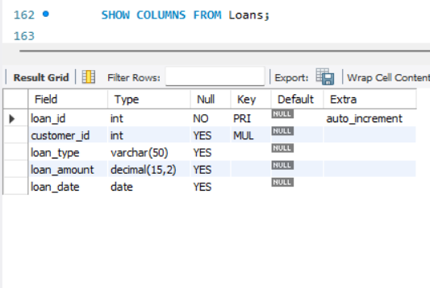

Slide 27
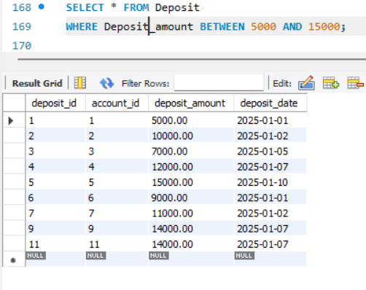
BETWEEN -
The BETWEEN command is used to select values within a given range. The values can be numbers, text, or dates.

Slide 28
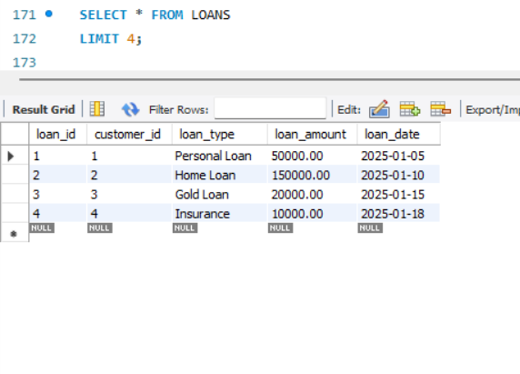
LIMIT - The SQL LIMIT clause is used to specify the maximum number
of rows that should be returned from a query.

Slide 29
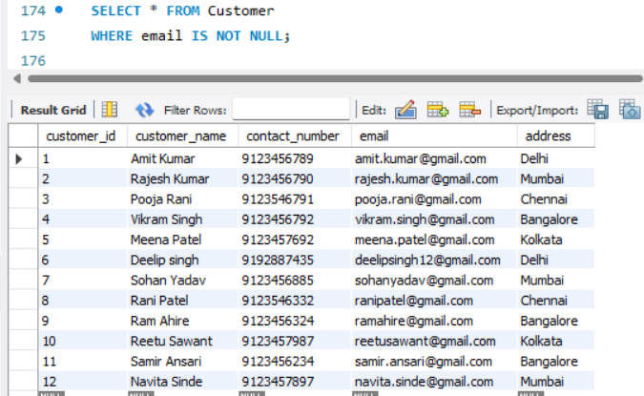
WHERE CLAUSE - The WHERE clause is used to filter records.
It is used to extract only those records that fulfill
a specified condition.

Slide 30
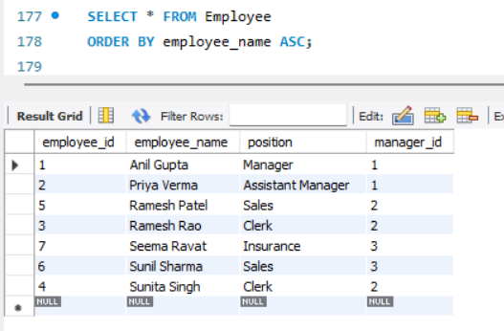
ORDER BY CLAUSE - The ORDER BY clause in SQL is used to sort the result
set of a query in
a specific order based on one or more columns.

Slide 31
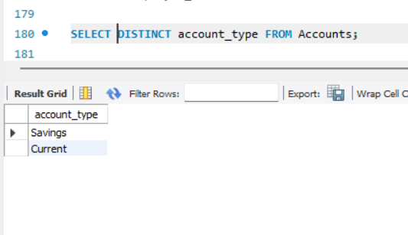
DISTINCT keyword is used to retrieve unique values from a specified column or
set of columns in a database table.

Slide 32
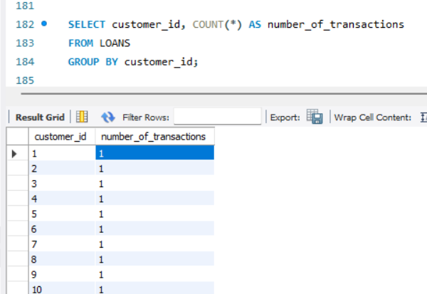
GROUP BY clause in SQL is used to group rows that have the same values
in specified columns, allowing for aggregate functions (like COUNT, SUM, AVG, et.)

Slide 33
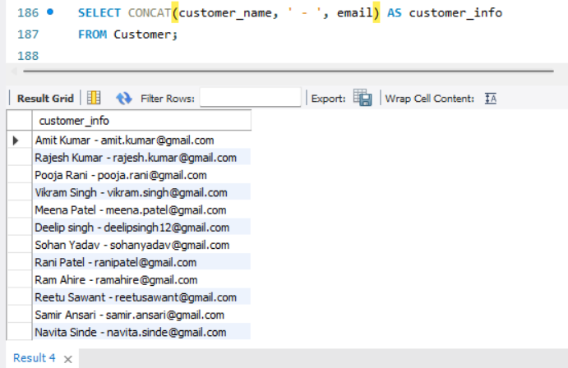
CONCAT() is a function used to concatenate (combine) two or more strings into a single string.
multiple string arguments and returns one string that is the result of joining them together.

Slide 34
JOIN is a type of SQL join that returns only the rows where there is a match in both tables being joined.
Join Types:
INNER JOIN: Returns only matching rows.
LEFT JOIN: Returns all rows from the left table, matching rows from the right table.
RIGHT JOIN: Returns all rows from the right table, matching rows from the left table.
CROSS JOIN: Returns all possible combinations of rows.
SELF JOIN: Joins a table with itself.

Slide 35
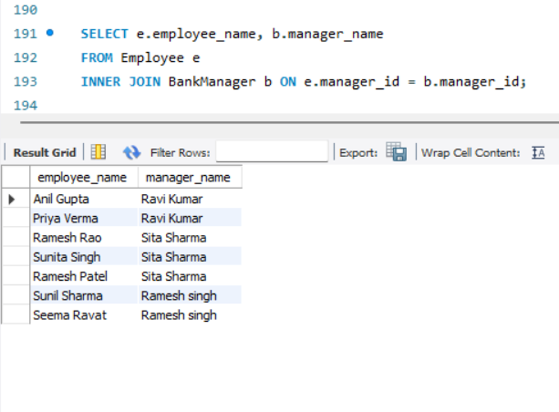
INNER JOIN is a type of SQL join that returns only the rows where there is a match in both tables being joined.

Slide 36
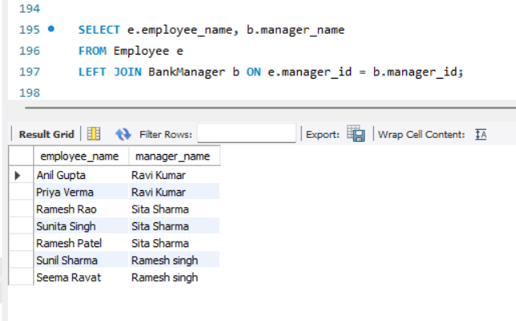
LEFT JOIN is a type of join in SQL that returns all the rows from the left table
and the matched rows from the right table .

Slide 37
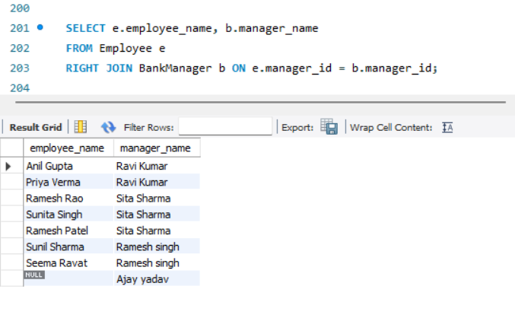
RIGHT JOIN is a type of join in SQL that returns all the rows from the right table
and the matched rows from the left table .

Slide 38
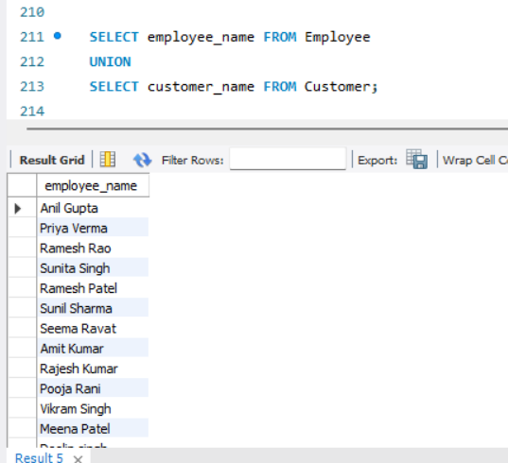
UNION operator is used to combine the results of two or more select queries into a single result set

Slide 39
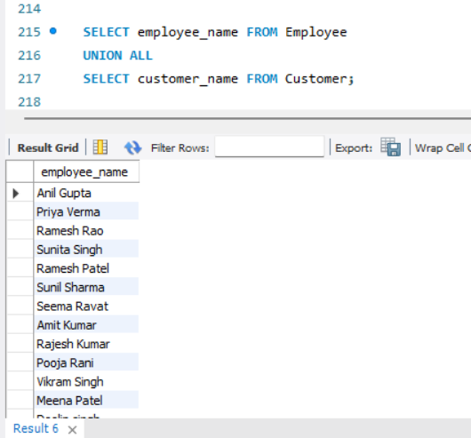
UNION ALL operator in SQL combines the results of two or more SELECT queries into a
single result set without removing duplicates.

Slide 40
SUBQUERY A subquery is a query embedded inside another query. It is used to retrieve data that will be used in the main query. Subqueries allow you to perform more complex operations, and they are often used in SELECT, INSERT, UPDATE, or DELETE statements.
Types of Subqueries –
Single-row Subquery
Multiple-row Subquery

Slide 41
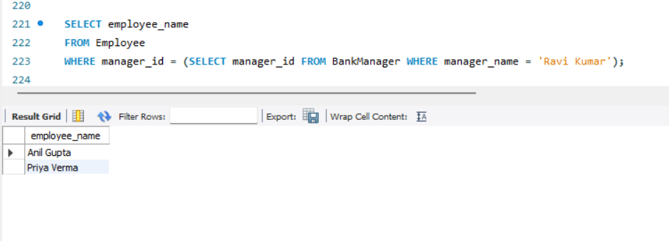
Single-row Subquery

Slide 42
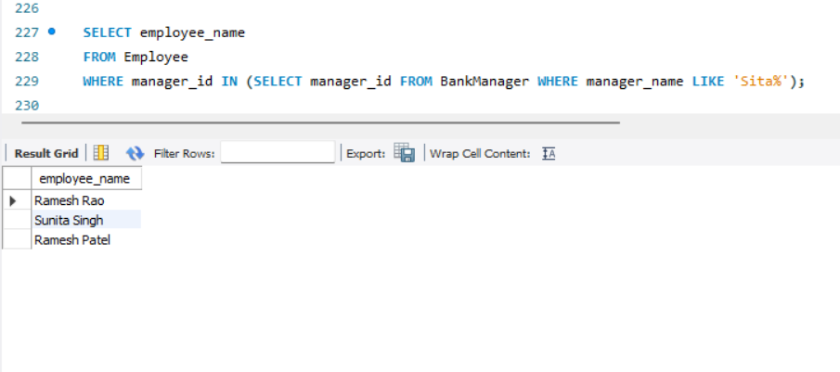
Multiple-row Subquery

Slide 43
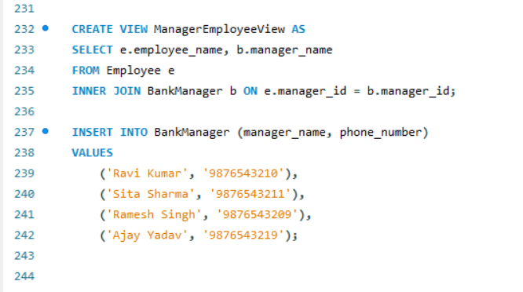
VIEW in MySQL is a virtual table that is based on the result of a SELECT query.
It doesn't store data itself; instead, it presents data from one or more underlying tables.
Views are useful for simplifying complex queries, abstracting data.

Slide 44
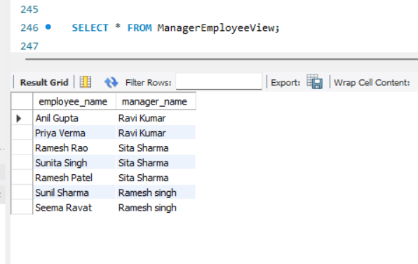
SELECT * FROM ManagerEmployeeView;

Slide 45
DROP TABLE statement is used to delete a table from the database, including all its structure and data.
Once a table is dropped, it cannot be recovered unless there is a backup.
DROP TABLE Employee;

Slide 46
BankManager: Stores information about bank managers (e.g., name, contact details).
Employee: Contains details about bank employees, linked to managers through a foreign key.
Customer: Stores customer details such as name, contact, email, and address.
Accounts: Holds information on customer bank accounts, including balance and type.
Deposit: Logs deposit transactions for accounts, with the deposit amount and date.
Loans: Keeps track of loans issued to customers, including type, amount, and date.
Bank Management System summary -:

Slide 47

THANKU YOU

